Slide 1

Glaz Project
Team:
Raed Messaoud oualid Guellouz Wajdi jouini

Slide 2

Project’s Context
- The context of the project is about offering services of cleaning and babysitting to clients.
- Through a site ,the client will hire a cleaning lady or a babysitter.

Slide 3
NEEDS
How can I go outside with my partner with leaving children in the house?
How can I enjoy my free time with the burden of many chores(cleaning house, taking care of children)?

Slide 4
Solutions
Having a reliable and trustworthy cleaning service
Having a reliable and trustworthy babysitting service

Slide 5
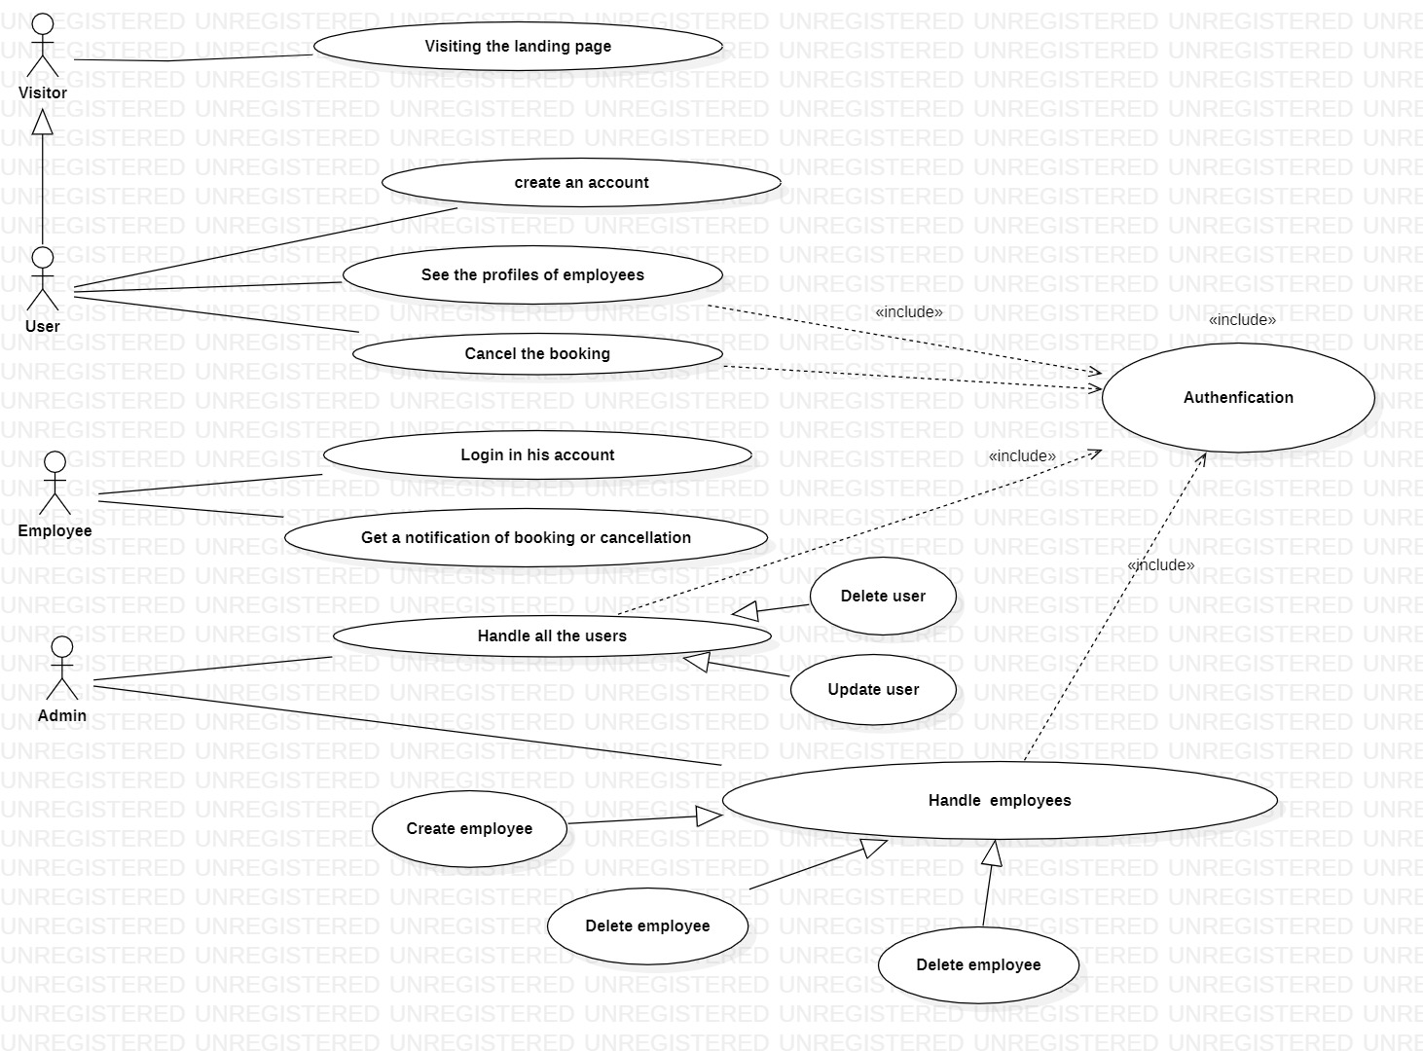

Logical
Architecture

Slide 6

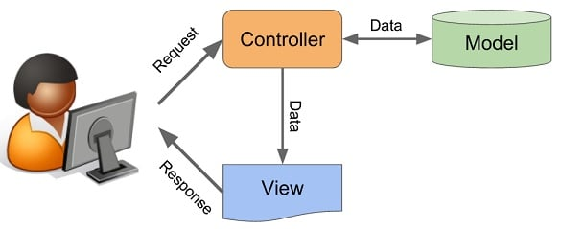
Technical Architecture

Slide 7







Tools/Technologies
User-facing interface(Front-End):
Back-End:
Database:

Slide 8
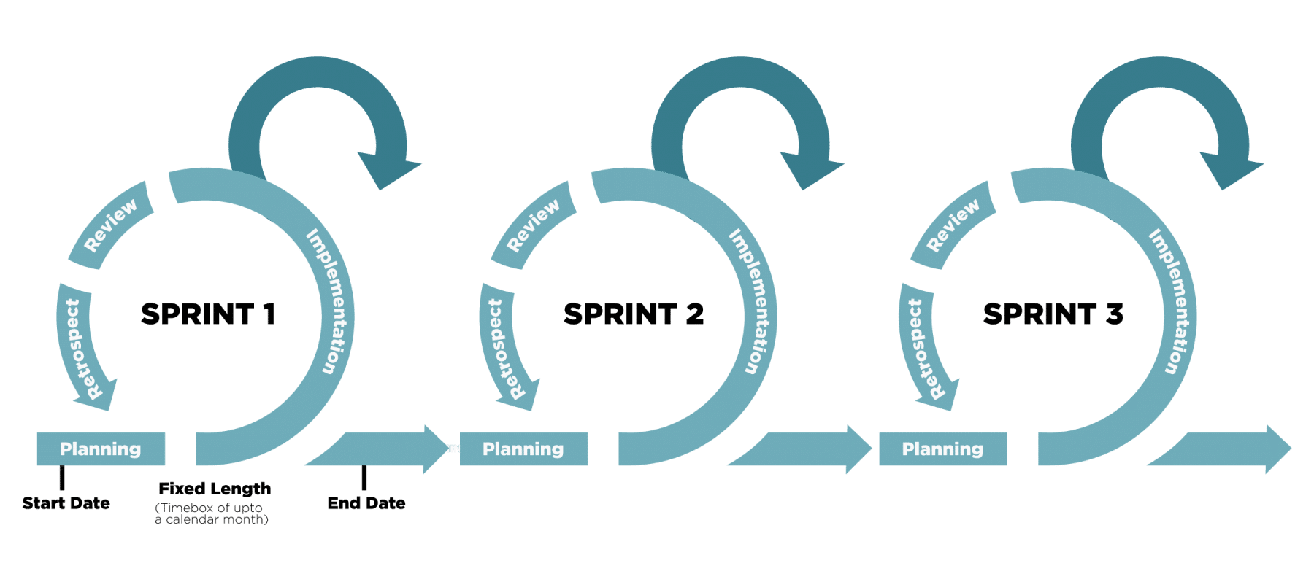
Methodologies
Scrum/sprint/Agile
Front-end:

Slide 9
Methodologies
Scrum/sprint/Agile
Back-end:

Slide 10
Challenges
1- How to create a link between one customer and many services offered.
2-How to link the user’s address to the closest employee ready for the service.
3 How to make sure the customer can do a booking for a service and make a confirmation from the employees plateform.

Slide 11
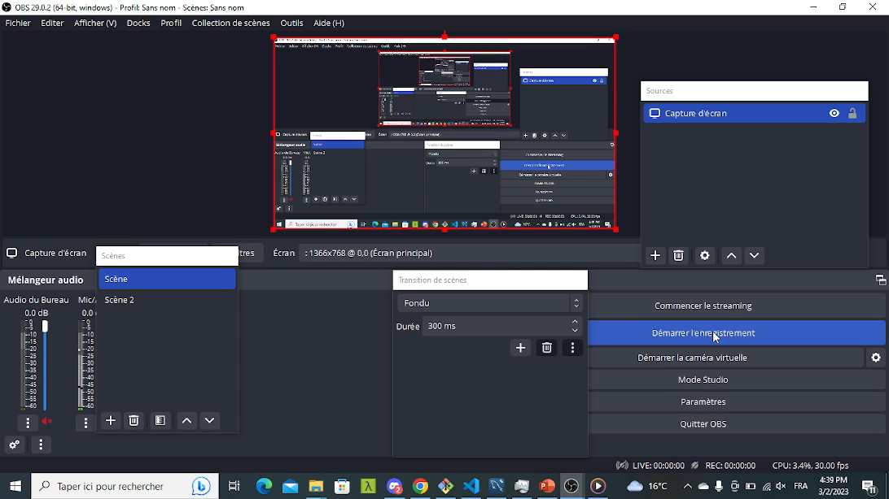

Slide 12
Roadmap / What’s Next
1- Create a chat plateform between employees and customers.
2- Create an IOT link between the employee and the customer.
3- Create coupons of reduction for the loyal clients.
4-create a functionnal payment system.

